Slide 1
Schistosoma Parasites
Called Blood Flukes
Adult Flukes live in blood vessels of infected Humans
S.haematobium
S.mansoni
S.japonicum
D.H: Man
R.H: None
D.H: Man
R.H: Rodent, Monkeys
D.H: Man
R.H: Domestic animals

Slide 2
Definitive Host
Man
Habitat
Blood vessels
Vesical & pelvic plexus of veins
Where adult S.haematobium live

Slide 3
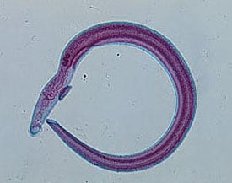
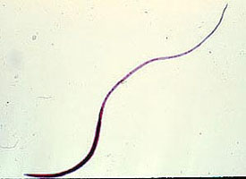
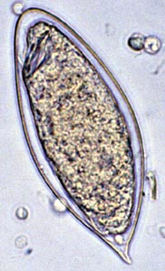
Male
Female
Egg
S. haematobium
10x 1 mm
3-5 testes in a line
Fine tubercles
S. haematobium
20x0.2 mm
Ovary post 1/3
Vit. gl. post 1/3
S. haematobium
In urine
140x 60 μ
Oval terminal spine
translucent, non operculated
Mature embryo (miracidium)

Slide 4
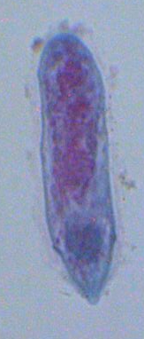
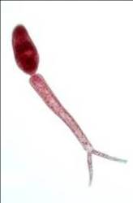
Miracidium
Infective stage (Cercaria):
Formed of body and
forked tail (furcocercous)
5-6 pairs of penetration
glands.
Skin penetration is aided by:
1-Proteolytic enzymes.
2-Surface tension of drying
water.
3-Movement of the tail
Snail I. H
S. haematobium
Bulinus truncatus

Slide 5
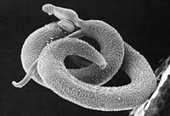
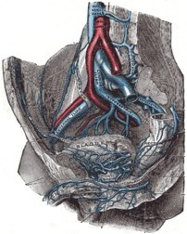
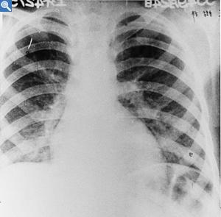
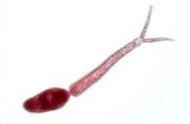
Worms mate in the liver
Worms in their habitat
Schistosomulum reaches circulation
Female lays eggs
Miracidium infects snail i.h.
Eggs in urine
Infection in contaminated water
Cercarial shedding
Miracidia hatch

Slide 6
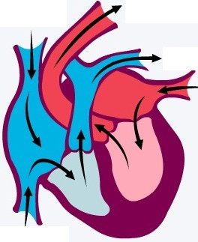
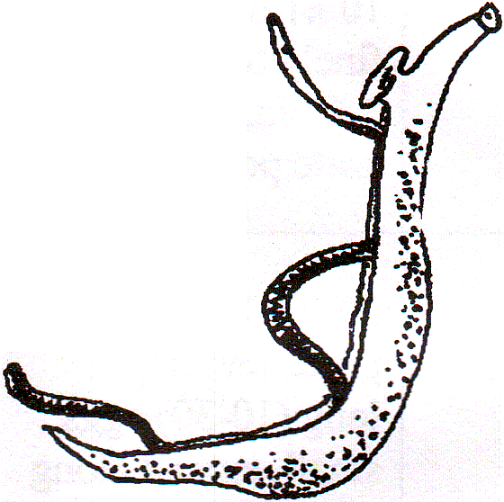
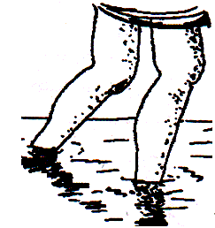
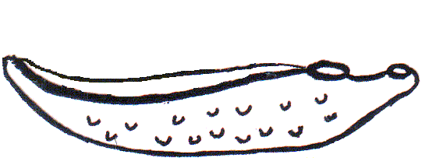
Development of Schistosoma inside the body of infected human
Aorta
II
Systemic circulation
Venous circulation
Liver
Schistosomula
♀
Vesical plexus
♂
I
S.haematobium
Portal vein
Cercariae penetrates human skin
III
IV
Direction of venous blood flow
In urine

Slide 7
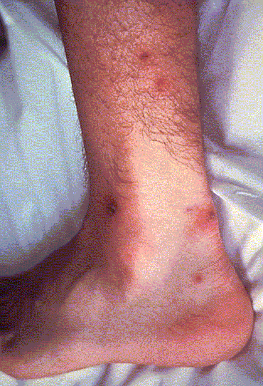
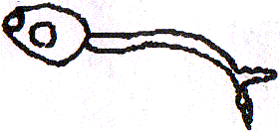
Pathogenesis and Clinical Picture
There are 4 progressive stages:
I- Stage of invasion
(1-4 days)
Local dermatitis, irritation.
Papular rash.

Slide 8
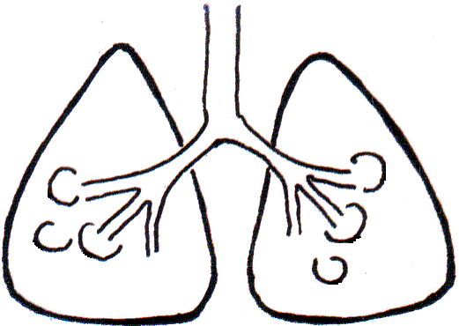
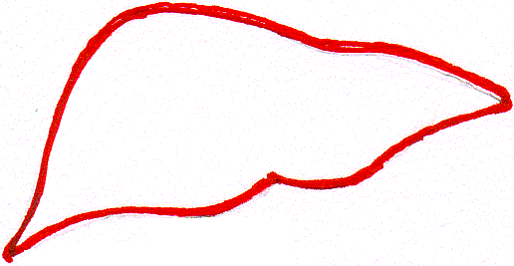
II- Stage of migration
(3-4 weeks)
By schistosomula
Metabolic products: toxic and allergic manifestations as
urticaria, fever, headache, muscle pain.
In the lung: verminous pneumonitis, minute haemorrhage
cough, haemoptysis.
In the liver: enlarged and tender.

Slide 9
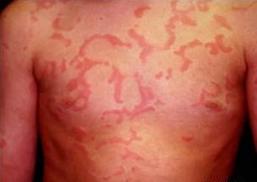
III- Stage of egg deposition and extrusion
(acute stage: 1-2 month)
A- Eggs are deposited in the venous plexus
The patient may complain of:
Generalized malaise, fever,
rigors, urticaria, abdominal pain
and liver tenderness.
Urticaria

Slide 10
B- Stage of egg extrusion:
1-Pressure within the venule
2-Effect of the spine
Eggs escape from the veins to the perivascular tissue due to:
3-oozing lytic secretion of the miracidium within the egg
Damage & haemorrhage
S.haematobium
In vesical & pelvic plexus of veins
Bladder wall
Egg extruded
Terminal haematuria, frequency of micturition, burning pain

Slide 11
IV- Stage of tissue reaction (chronic stage)
(months – years)
Shell & miracidial antigens
Occurs around Schistosoma eggs deposited in various tissues.
Granuloma formation in tissue
Granuloma develops
Attract inflammatory cells
Deposition of fibrous tissue
miracidium
Damage of affected organ and its fibrosis
Inflammatory cells
Egg shell
Delayed-type hypersensitivity
Loss of its function

Slide 12
In normal condition
In S.haematobium infection
hydronephrosis
hydroureter
Fibrous tissue
Egg trapped in bladder wall
Stone formation
Cancer bladder may occur

Slide 13
IV- Stage of tissue reaction (chronic stage)
In S.haematobium infection
Eggs fail to fix to venule wall are swept by blood
3
2
Eggs trapped in Bladder wall
Eggs extruded in urine
1
Cause Embolic lesions

Slide 14
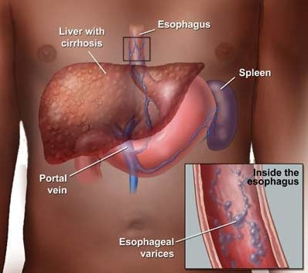
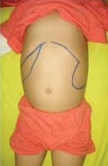
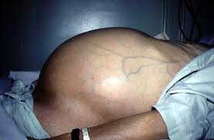
Embolic Lesions in the Liver
Portal hypertension
Hepatosplenomegaly
Oesophageal varices
Ascites.

Slide 15
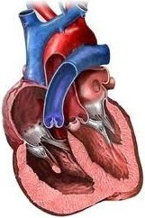
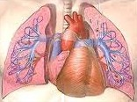
Embolic Lesions in the lung
Bilharzial cor-pulmonale
Pulmonary hypertension
In Schistosoma infection
In Normal condition
Trapped eggs
Dilated right ventricle
Thickened wall
Enlarged right ventricle
Cor-pulmonale = right-sided heart failure
Means: enlargement of right ventricle due to high blood pressure in the arteries of the lung
Embolic lesions may occur in any other organ.

Slide 16
Diagnosis of Schistosomiasis
Clinically
Laboratory
Radiological imaging
Endoscopy
(suggestive)
1- History of contact with infected water.
1- Detection of eggs in urine.
2- Clinical picture according to stage of infection.
2- Blood examination
3- Serological tests

Slide 17
I- Laboratory Diagnosis
1- Direct parasitological methods:
- Detection of S.haematobium eggs in urine.
- Test for viability.
S:
140X60 µ
S:
Terminal spine
Oval, thin shell
C:
Translucent
C:
Miracidium

Slide 18
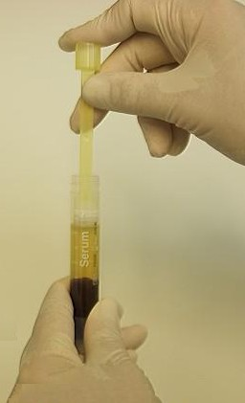
I- Laboratory Diagnosis
2- Blood examination:
1- Egg extrusion
Iron deficiency anaemia
Anaemia due to
2- Hypersplenism
Eosinophilia, leucocytosis.
Haemolytic anaemia
3- Serological Tests:
(Immunodiagnostic Tests)
Detection of anti-Schistosoma antibodies or antigen in patient’s serum
a- IHAT (Indirect Haemagglutination test)
Sensitized sheep RBCs
Latex particles
+ve
-ve

Slide 19
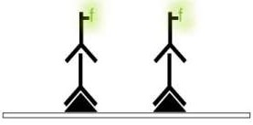
b- ELISA (Enzyme-linked immunosorbent assay)
Coating with Schisto Ag
Patient’s serum
Ab linked to enzyme
substrate
Ab detected
wash
wash
wash
Coating with anti-Schisto MAb
Patient’s serum
Ab linked to enzyme
substrate
Ag detected
wash
wash
wash
c- IFAT (Indirect Fluorescent Antibody test)
Patient serum
Ab detected
Schisto Ag
wash
wash

Slide 20
II- Radiological imaging
S.haematobium infection
Calcified bladder with hydroureter
Stenosed ureters and hydronephrosis

Slide 21
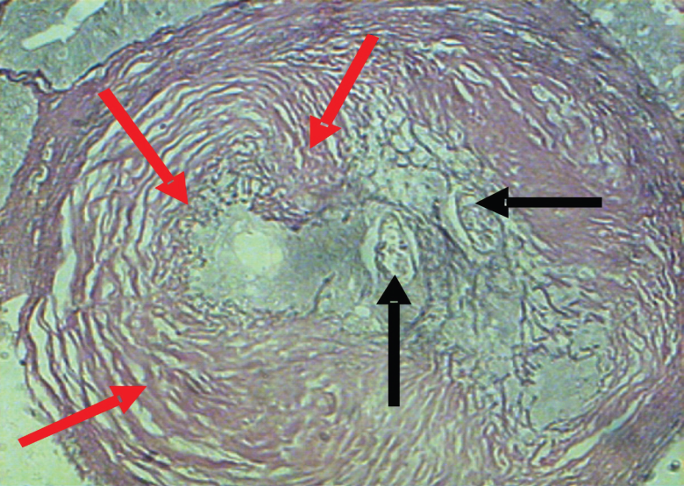
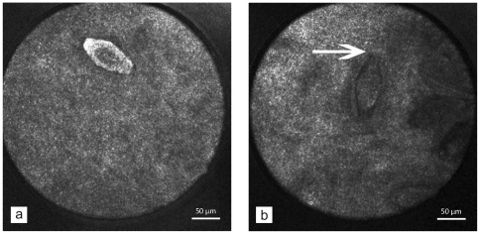
المناظير III- Endoscopy
Cystoscopy in S.haematobium
Done in chronic cases to detect lesions and take biopsies

Slide 22
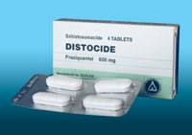
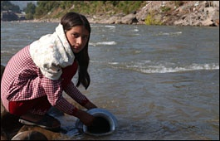
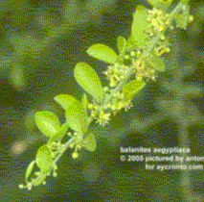
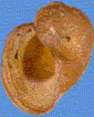
Treatment
Praziquantel (Biltricide):
For all schistosome species.
Dose:40 mg/kg single oral dose
Metriphonate:
For S. haematobium only.
Dose: 10mg/kg every 2 weeks for 3 doses.
Prevention and Control
- Mass treatment.
- Health Education.
- Snail control:
Physical methods
Biological methods
Chemical methods
X
Copper sulphate

